Slide 1
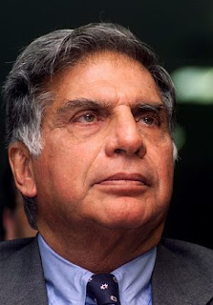
RATAN TATA
A LEGACY OF VISIONARY LEADERSHIP
PRESENT BY
SMRITI, SONIYA

Slide 2
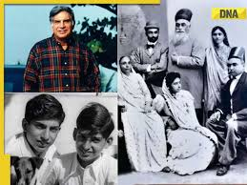
Most Successful Business man in the World
Ratan Naval Tata was his full name, one of India’s most iconic business leaders, has left an indelible mark on the country’s corporate landscape.
Born on December 28, 1937, in Mumbai, India, Ratan Tata is the grandson of Jamshedji Tata, founder of the Tata Group.
Father- Naval Tata, Mother- Sooni Tata
He has taken Tata group to new heights and under his leadership, group revenues have grown manifold.
A person who is well known for his business ethics and philanthropy.

Slide 3
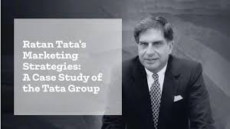
Studies Of Ratan Tata
He finished up school cathedral and john connon school
Carmel university he got BS degree in architecture in structure engineering in 1962
He went to hardvork business school for degree in advanced management program in 1975
Childhood he was always interest in cars

Slide 4
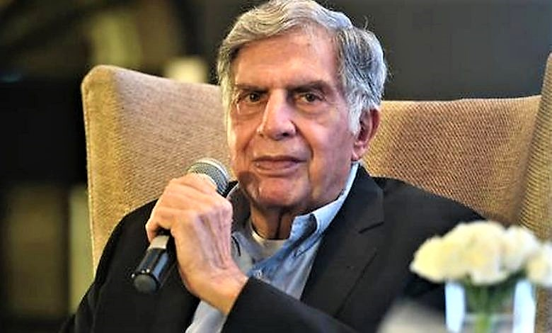
Started his Career
Started career in 1960 in tata group’s as a general worker in tata steel.
Success story speaks for itself but we see his rise in the ranks of jrd tata resigned from chairman of tata group as his success in 1991.
Chairman of Tata Sons:1991-2012
Global brand across the world.

Slide 5
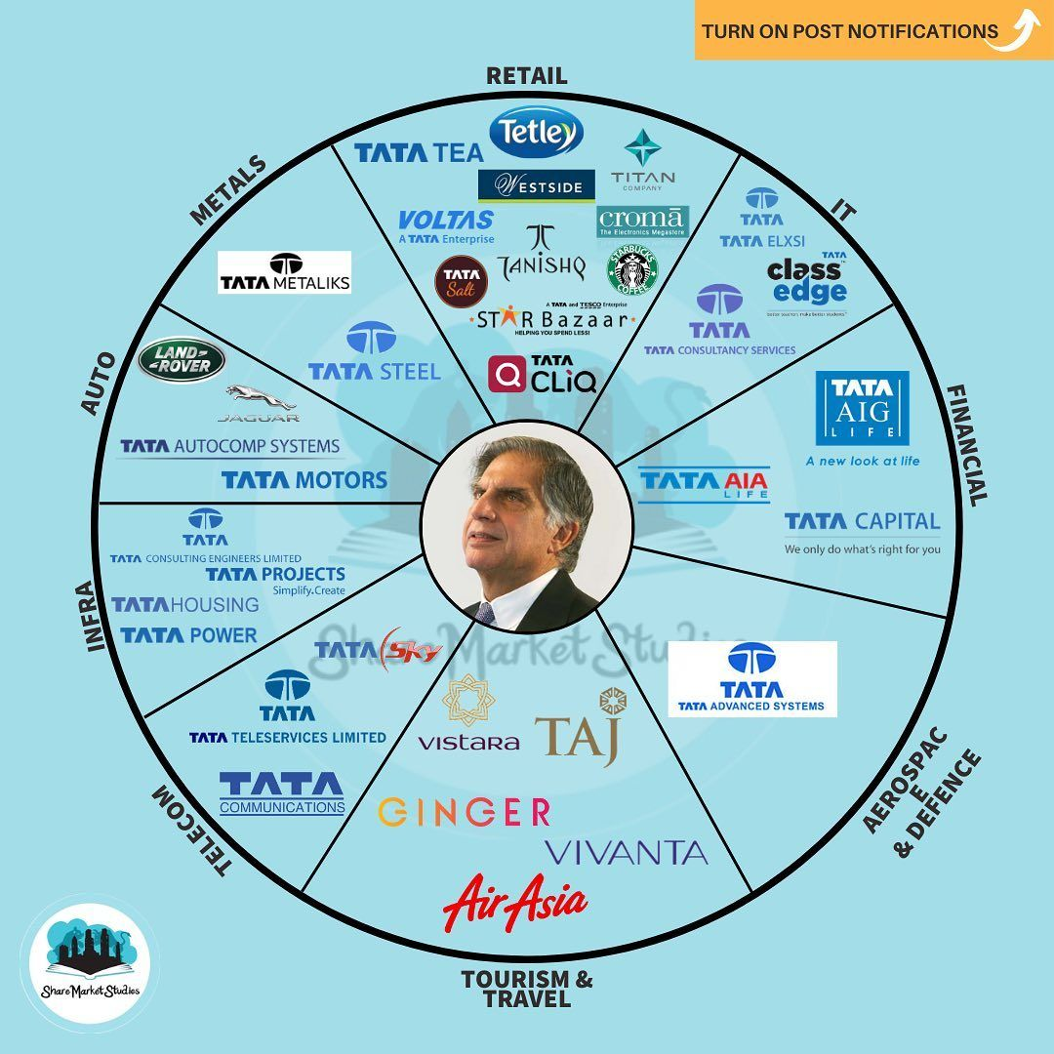
Leadership at Tata Group
Became chairman of tata sons in 1991
Focused on innovation, globalization, and modernizing the group.

Slide 6
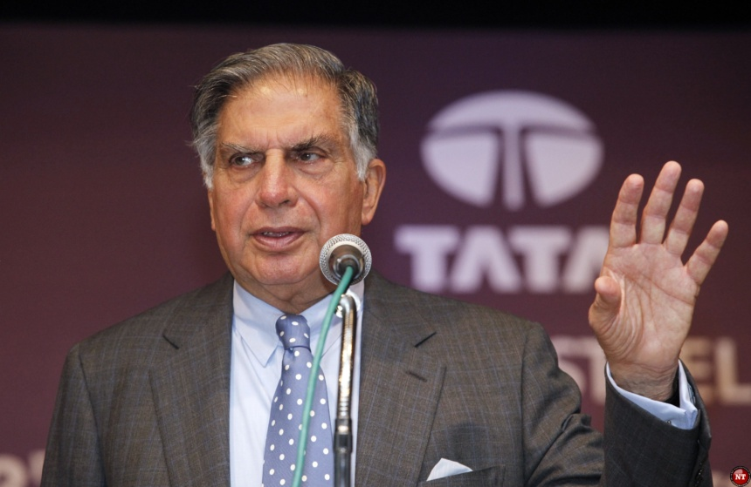
JOURNEY
Chairman- Tata Sons and Tata Group
Chairman
Tata steel
Tata motors
Tata power
Tata consultancy services
Tata tea
Tata chemicals
The Indian hotels company
Tata teleservices

